Slide 1



Static Techniques
Testing Without Executing the Code
Software Quality Assurance
Telerik Software Academy
http://academy.telerik.com

Slide 2
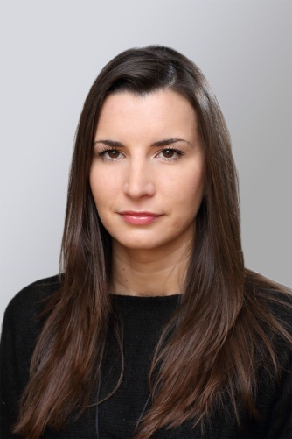
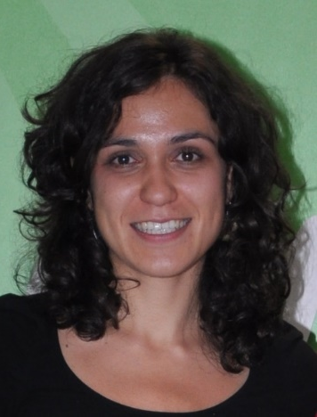
The Lectors
Snejina Lazarova
Product Manager
Talent Management System
Asya Georgieva
Junior QA Engineer
Telerik Academy & AppBuider

Slide 3

Table of Contents
Static Techniques – Main Concepts
Static Analysis
Reviews

Slide 4

Static Techniques
Main Concepts

Slide 5
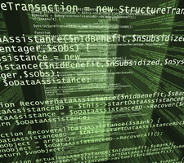
What is Static Testing
What is static testing?
Static testing can be defined as testing a system without executing its code
Static testing can be two main types:
Manual examination – reviews
Automated analysis – static analysis

Slide 6
Why Should We Use It
Find weaknesses in the code
Defects found early by reviews are cheaper to fix
Follow specific rules
Static analysis supplements dynamic testing for a better and more efficient test coverage

Slide 7
What Can Static Analysis Be Used For
Typical defects that are easier to find in reviews than in dynamic testing include:
Deviations from standards
Requirement defects
Design defects
Insufficient maintainability
Incorrect interface specifications

Slide 8

Static Analysis by Tools

Slide 9

Static Analysis
The term static analysis refers to using tools for automated code analysis
Static analysis can locate defects that are hard to find with dynamic testing
Static analysis finds potential defects rather than failures
Notes:
http://en.wikipedia.org/wiki/List_of_tools_for_static_code_analysis

Slide 10

Deriving Metrics
An additional objective of static analysis is to derive measurements, or metrics
In order to measure and prove the quality
Typical measures are:
Number of calls to a method
How many times a variable has been accessed

Slide 11
The Compiler is an Analysis Tool
All compilers carry out a static analysis of the program under test
Making sure that the correct syntax of the programming language is used
Further information can be generated
Undeclared variables
Unreachable code
Overflow or underflow of field boundaries
Notes:
Software Testing Foundations - A Study Guide for the ISTQB Certified Tester Exam [2007]

Slide 12

Static Analysis Targets
Static analysis tools can be used to analyze:
Program code
E.g. control flow and data flow
Generated output
E.g. DLL, HTML and XML
Notes:
ISTQB – Foundation Level Syllabus

Slide 13
Finding Security Problems
Static analysis can be used in order to detect security problems
Error-prone program constructs used
Necessary checks are not done
Examples:
Lack of buffer overflow protection
Failing to check that input data may be out of bounds

Slide 14
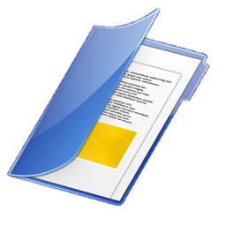
Formal Documents
The document to be analyzed must follow a certain formal structure
In order to be checked by a tool
Formal documents can be
The technical requirements
The software architecture
The software design
UML, HTML or XML documents
E.g. class diagrams in UML

Slide 15
Value of Static Analysis
Early detection of defects prior to test execution
Early warning about suspicious aspects of the code or design by the calculation of metrics, such as a high complexity measure
Identification of defects not easily found by dynamic testing
Detecting dependencies and inconsistencies in software models such as links

Slide 16
Defects discovered by static analysis tools
Referencing a variable with an undefined value
Inconsistent interfaces between modules and components
Variables that are not used or are improperly declared
Unreachable (dead) code
Security vulnerabilities
Syntax violations of code and software models

Slide 17
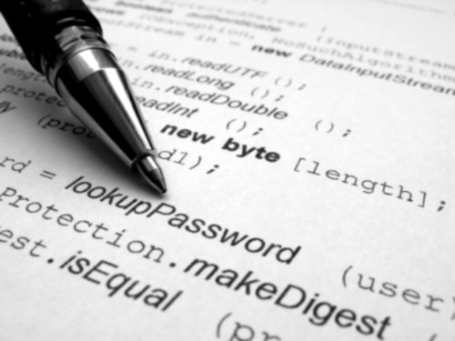
Reviews
Human-Driven Examination of the Code

Slide 18
What is a Review
What is a review (quality review)?
A type of static testing
Could be code review, design review, test plan review, documentation review, etc.
A process or meeting during which a software product is examined by someone
In most cases done by the team members
To ascertain discrepancies from planned results
To recommend improvements
Finds defects by directly examining documents

Slide 19

What to Review
All types of documents can be subjected to a review
Source code
Requirements specifications
Design
Test plans
Documentation
Automated tests
Test cases

Slide 20

Why Reviewing
Reviews can have various objectives
Finding defects
Gain understanding
Verify standards are observed
Validate requirements are fulfilled
Brainstorming

Slide 21
Where to Start
Technical
Formal
Informal
Non-technical

Slide 22
Formal Review Activities
Planning
Checking entry criteria
Defining entry and exit criteria
Selecting the personal
Allocating roles
Selecting which parts of the documents to review

Slide 23
Formal Review Activities (1)
Kick-off
Distributing documents
Explaining the objectives, process and documents to the participants
Individual preparation
Preparing for the review meeting by reviewing the document(s)
Noting potential defects, questions and comments

Slide 24
Formal Review Activities (2)
Review meeting
The meeting typically consist of the following elements
Logging phase
Discussions phase
Decision phase
The meeting participants may note defects, make recommendations for handling the defects, or make decisions about the defects

Slide 25
Formal Review Activities (3)
Rework
Fixing defects found
Typically done by the author
Recording updates status of defects
Follow-up
Checking the defects have been addressed
Gathering metrics
Checking on exit criteria

Slide 26

Roles and Responsibilities

Slide 27
Moderator
Moderator
Leads the review of the document or set of documents
Planning the review
Running the meeting
Following-up after the meeting
The moderator may mediate between the various points of view
Often he is the person upon whom the success of the review rests

Slide 28

Author
Author
The writer or person with chief responsibility for the document(s) to be reviewed

Slide 29
Reviewers
Reviewers (checkers, inspectors)
Individuals with a specific technical or business background
Identify and describe findings (e.g., defects) in the product under review
After the necessary preparation
Should be chosen to represent different perspectives and roles in the review process
Should take part in any review meetings

Slide 30
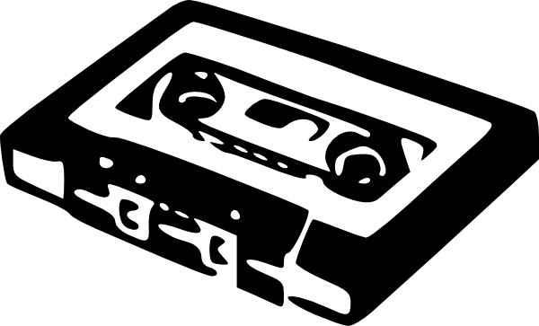
Scribe (Recorder)
Scribe (or recorder)
Documents all the issues, problems and open points that were identified during the meeting

Slide 31

Manager
Manager
Decides on the execution of reviews
Allocates time in project schedules
Determines if the review objectives have been met

Slide 32

Common Types of Reviews

Slide 33

Common Types of Reviews
A review can be performed in a different form:
Informal review
Walkthrough
Technical review
Inspection
Peer review

Slide 34
Informal Review
Informal review
No formal process
May take the form of pair programming or a technical lead reviewing designs and code
Results may be documented
Varies in usefulness
Depending on the reviewers
Main purpose: inexpensive way to get some benefit

Slide 35
Walkthrough
Walkthrough
Meeting led by author
May take different form:
Scenarios
Dry runs
Peer group participation
Sessions open-ended
Optional pre-meeting preparation of reviewers
Optional preparation of a review report including list of findings

Slide 36
Walkthrough (2)
Walkthrough
Optional scribe
Not the author
May vary in practice
From quite informal to very formal
Main purposes:
Learning
Gaining understanding
Finding defects

Slide 37
Technical Review
Technical Review
Documented, defined defect-detection process
Includes peers and technical experts
May be performed as a peer review without management participation
Ideally led by trained moderator
Not the author
Pre-meeting preparation by reviewers

Slide 38
Technical Review (2)
Technical Review
Optional use of checklists
Preparation of a review report which includes
List of findings
Verdict whether the software product meets its requirements
Recommendations related to findings (where appropriate)
May vary in practice
From quite informal to very formal

Slide 39
Technical Review (3)
Technical Review
Main purposes:
Discussing
Making decisions
Evaluating alternatives
Finding defects
Solving technical problems
Checking conformance to specifications, plans, regulations, and standards

Slide 40
Inspection
Inspection
Led by trained moderator
Not the author
Involves peers to examine the product
Defined roles
Includes metrics gathering
Formal process
Based on rules and checklists

Slide 41
Inspection (2)
Inspection
Specified entry and exit criteria for acceptance of the software product
Pre-meeting preparation
Inspection report including list of findings
Formal follow-up process
Optional process improvement components
Main purpose: finding defects

Slide 42

Peer Review
Peer review
Reviews performed within a peer group
I.e. colleagues at the same organizational level
Can be used for:
Technical reviews
Walkthroughs
Inspections

Slide 43
Static Techniques
?
?
?
?
?
Questions?
?
?
?
?
?
?

Slide 44
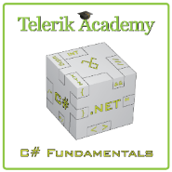



Free Trainings @ Telerik Academy
C# Programming @ Telerik Academy
csharpfundamentals.telerik.com
Telerik Software Academy
academy.telerik.com
Telerik Academy @ Facebook
facebook.com/TelerikAcademy
Telerik Software Academy Forums
forums.academy.telerik.com

